Slide 1

Knights Fury
Simon Zwenger
Maximilian Schubert

Slide 2
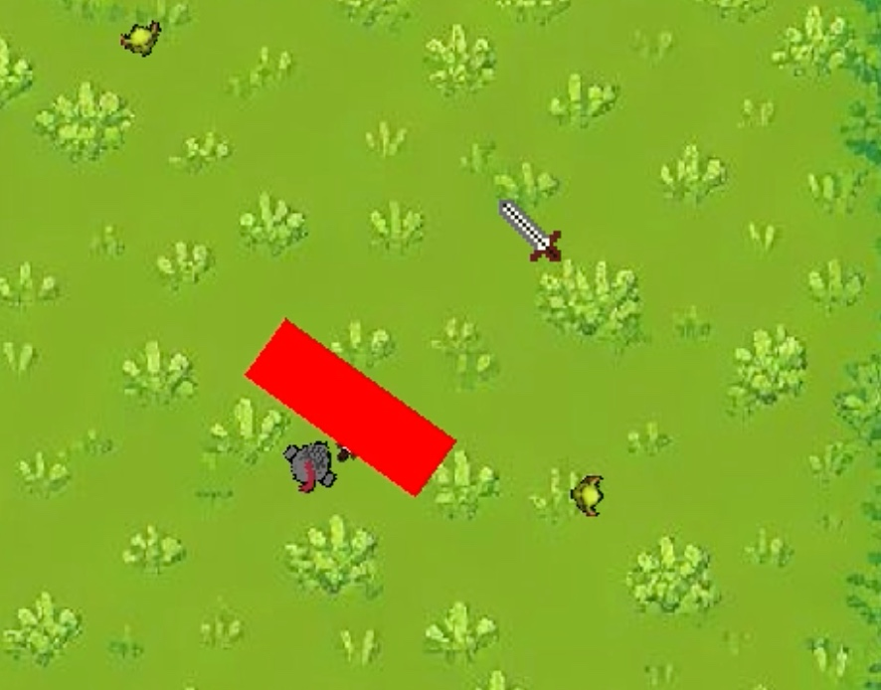
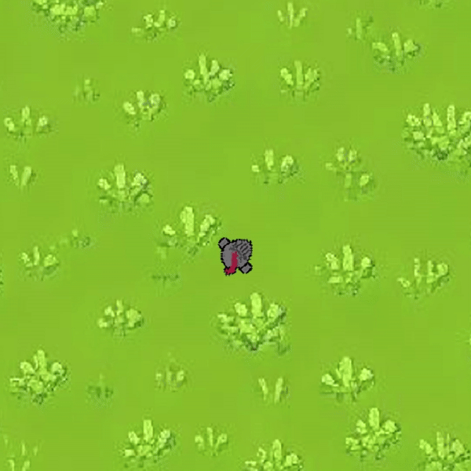
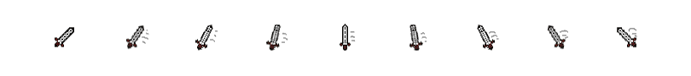
Attack Range

Slide 3
Attack Range
dy = mouse_pos[1] - player.middle[1]
dx = mouse_pos[0] - player.middle[0]

Slide 4
Attack Range
arctan = dx / dy
dy = mouse_pos[1] - player.middle[1]
dx = mouse_pos[0] - player.middle[0]

Slide 5
Attack Range
ty = self.size[0] * math.sin(angle -
math.pi / 2)
tx = self.size[0] * math.cos(angle - math.pi / 2)

Slide 6
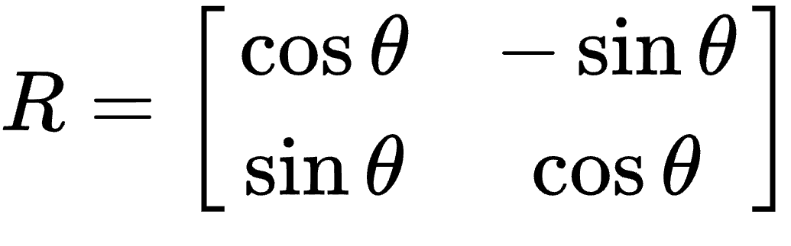
Attack Range
ty = self.size[0] * math.sin(angle -
math.pi / 2)
tx = self.size[0] * math.cos(angle - math.pi / 2)

Slide 7
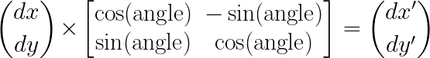
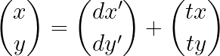
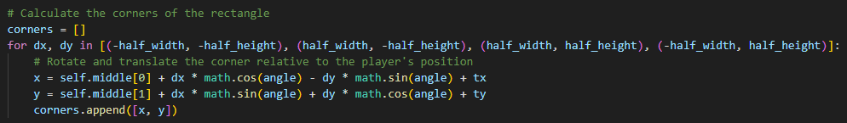
Attack Range
ty = self.size[0] * math.sin(angle -
math.pi / 2)
tx = self.size[0] * math.cos(angle - math.pi / 2)

Slide 8
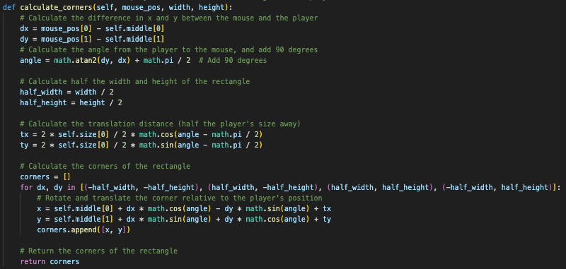
Code for Attack Range

Slide 9
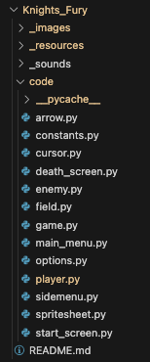
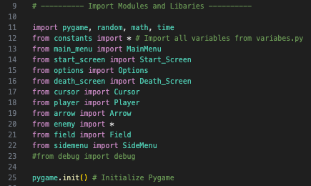
Code Structure

Slide 10
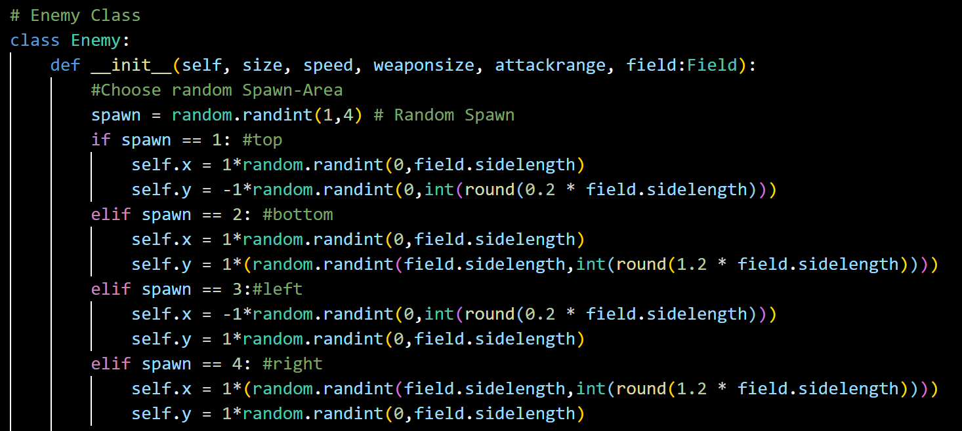
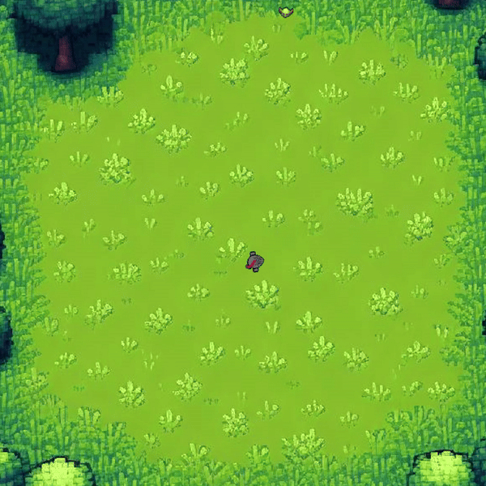
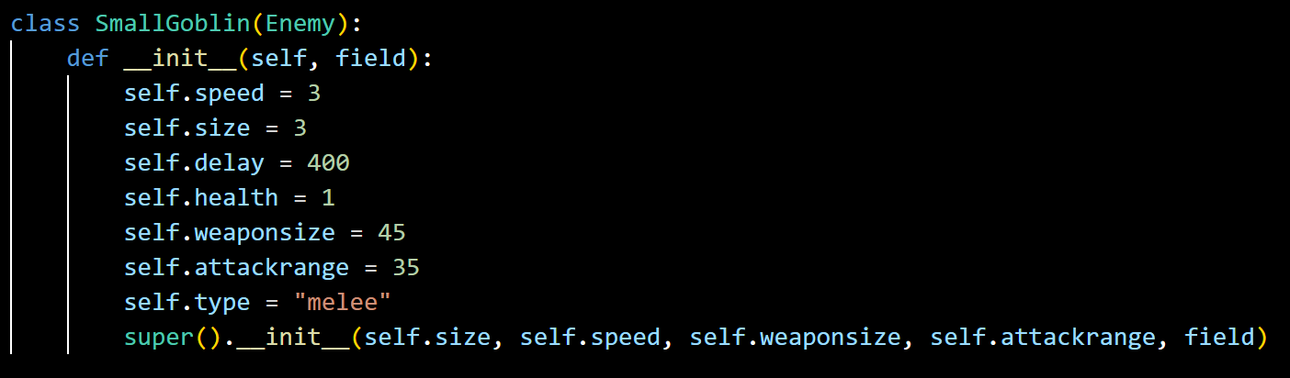


Enemy Class

Slide 11
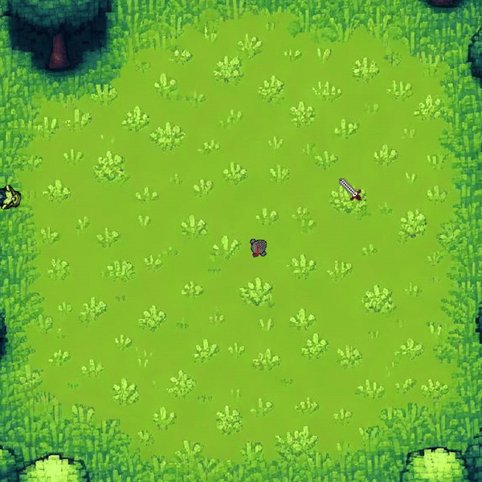
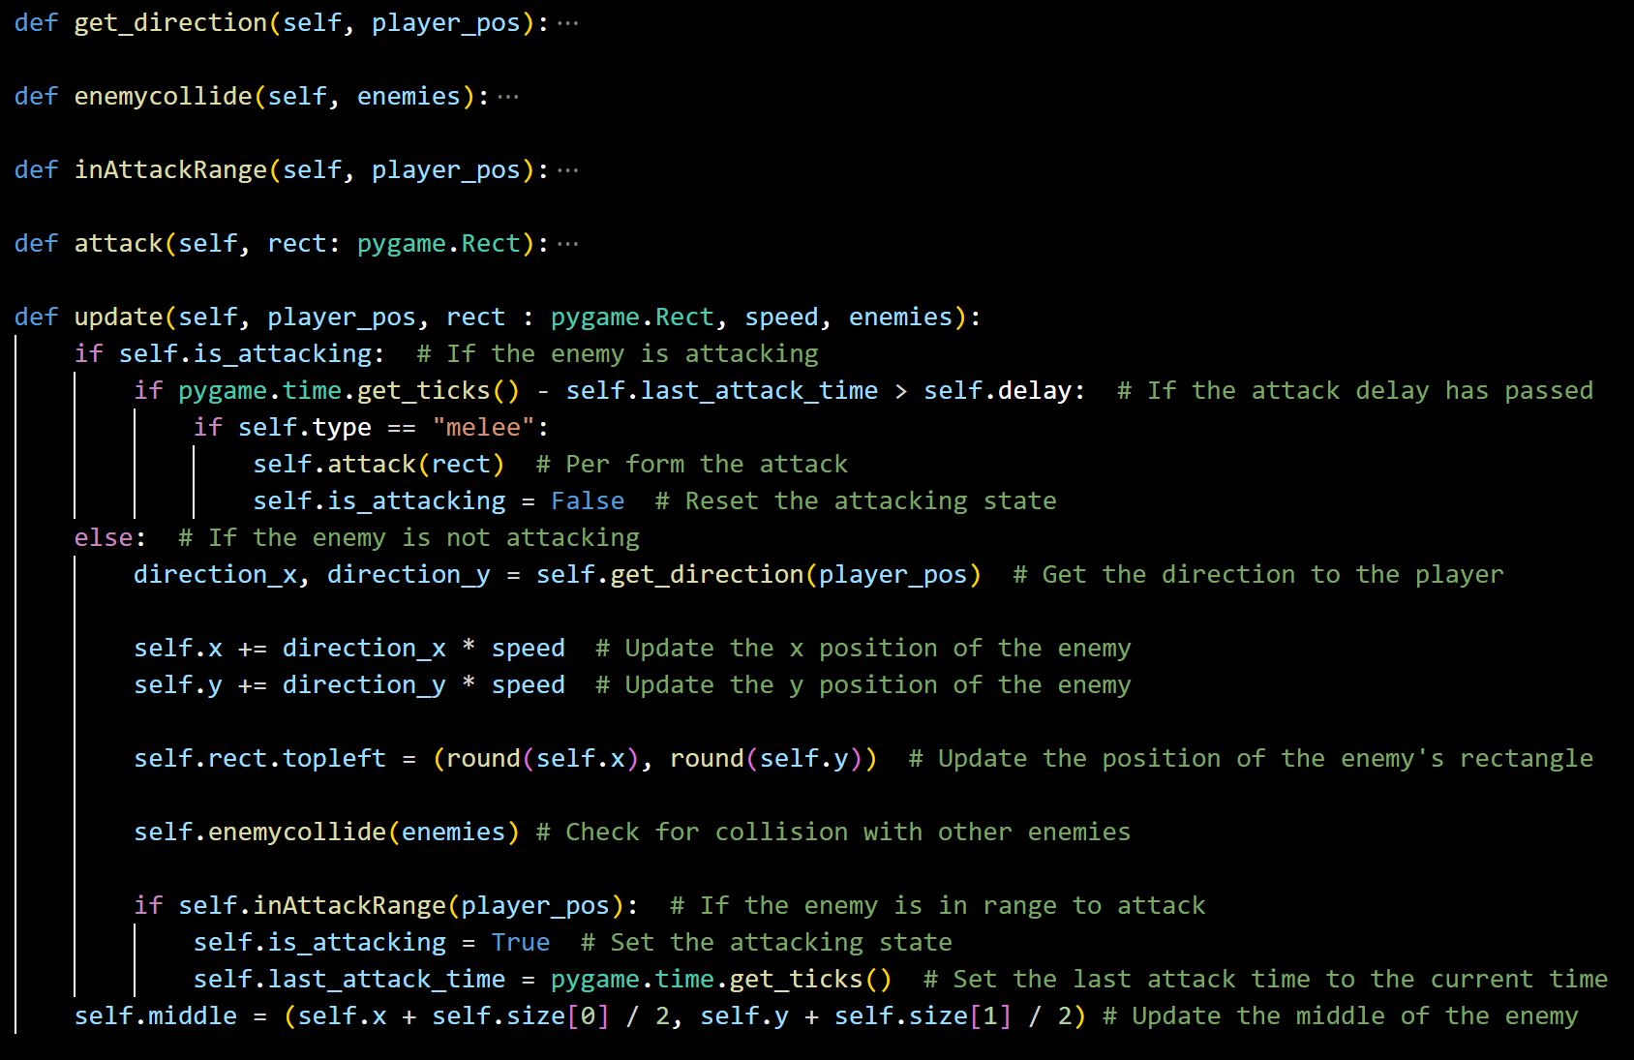

Slide 12
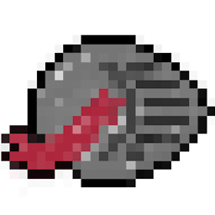
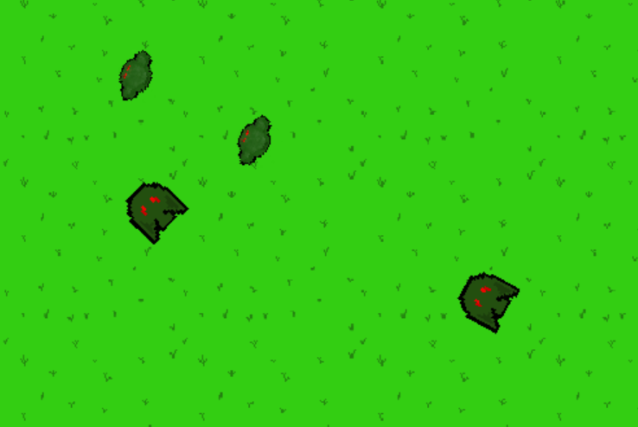
Old Graphics

